Slide 1
Bangla News Headlines Categorization
Presented By
1.Amran Hossain (BSSE 0917)
2. Niraj Chowdhury(BSSE 0942)
3. Zahid Hasan Rifad (BSSE 0944)
GroUp - VIII

Slide 2
Presentation Outline
Dataset Description
Methodology
Model Evaluation

Slide 3
Dataset Description
We have collected data from Kaggle.
There are three columns in our dataset. These are headlines, category and newspaper name. There are more then 0.13 million data in our dataset.
Dataset links:
https://www.kaggle.com/ishtyaquemikrani/bangladesh-news-headlines?utm_medium=social&utm_campaign=kaggle-dataset-share&utm_source=facebook

Slide 4
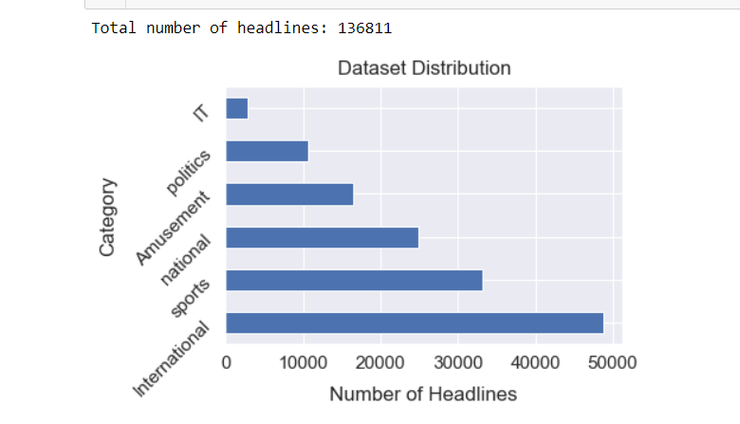
Dataset distribution
The headlines distribution of each categories represents in the following figure. This dataset is an imbalanced dataset.

Slide 5
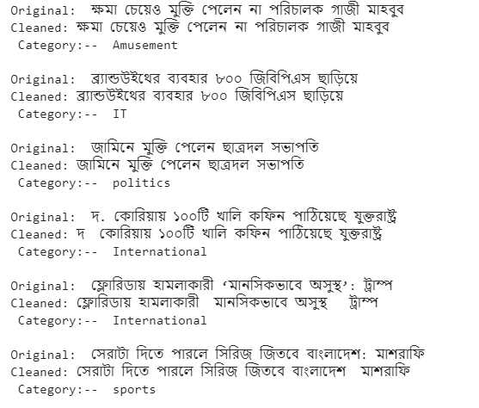
Data Clean
Remove unnecessary symbols from headlines using regular expression

Slide 6
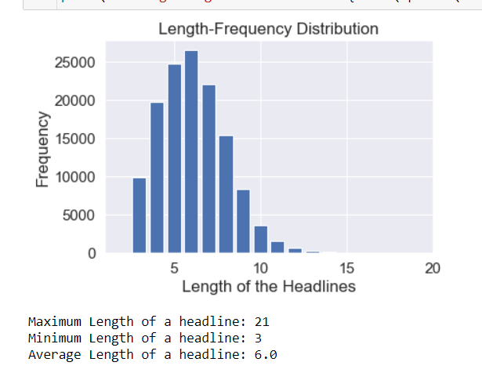
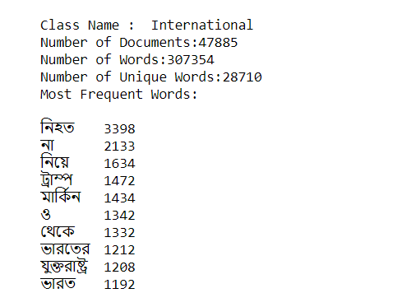
Data summary
Data summary includes the information about number of documents, words and unique words have in each category class. Also, include the length distribution of the headlines in the dataset.

Slide 7
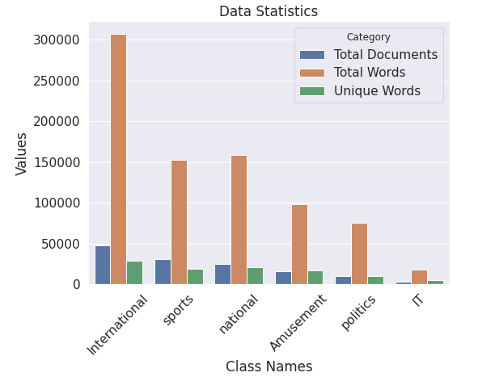
Data summary

Slide 8
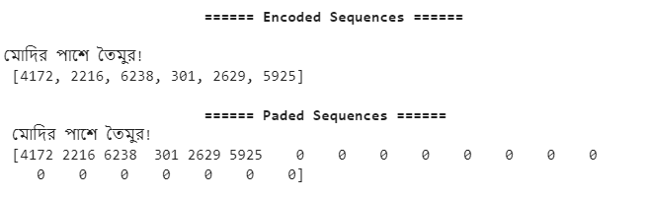
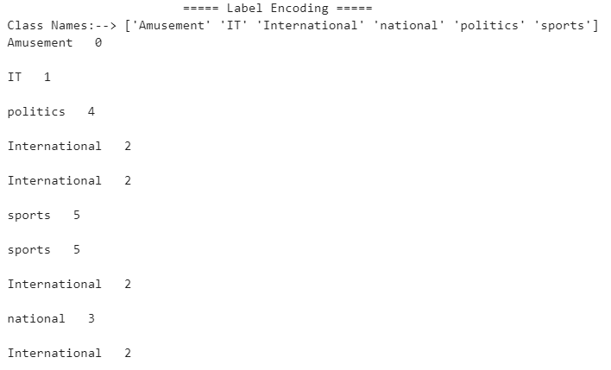
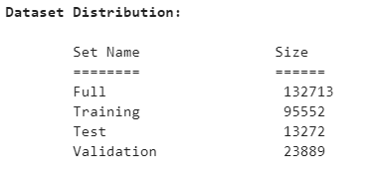
Data preparation for model
The text data are represented by a encoded sequence where the sequences are the vector of index number of the contains words in each headlines. The categories are also encoded into numeric values. After preparing the headlines.

Slide 9
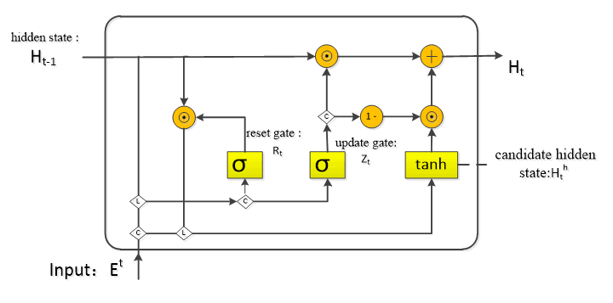




Methodology
GRU Model Architecture

Slide 10
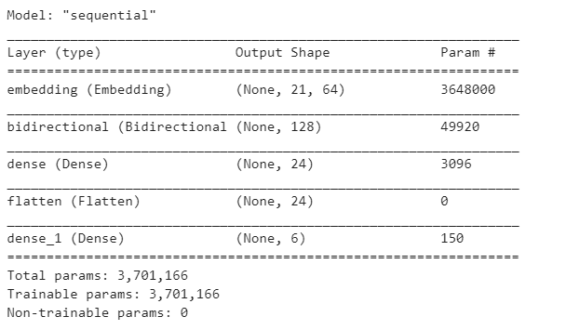
GRU Model Architecture

Slide 11
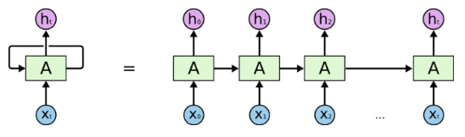
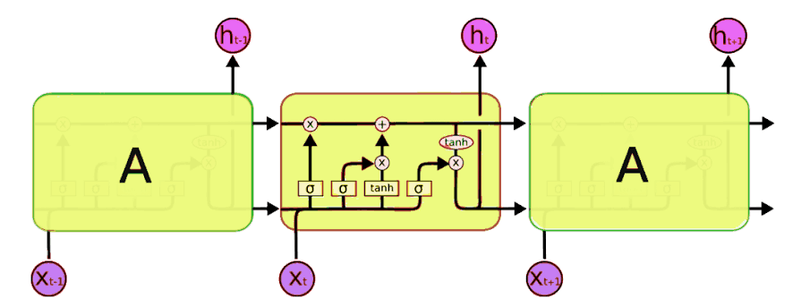
LSTM Model Architecture

Slide 12
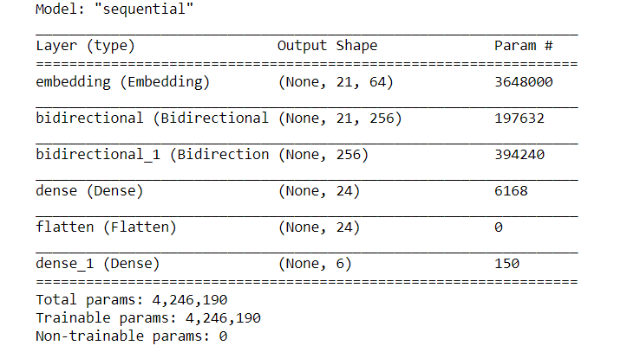
Lstm model architecture

Slide 13
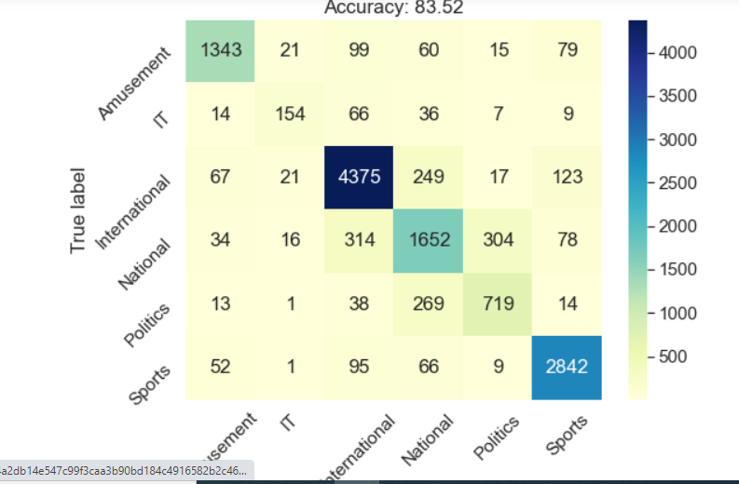
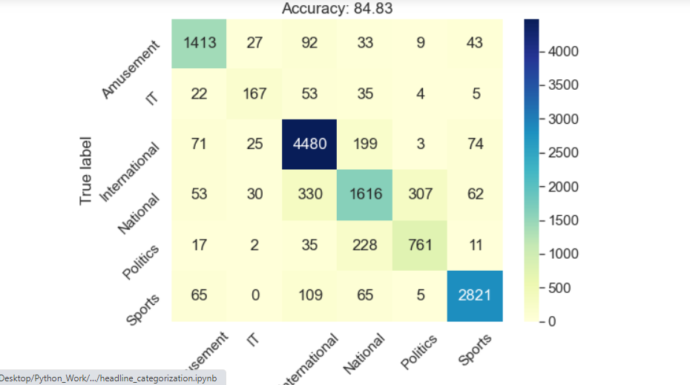
Model Evaluation
LSTM
GRU

Slide 14
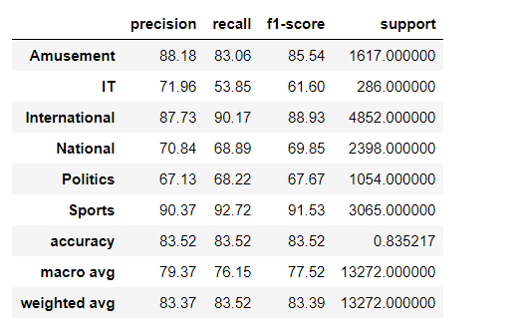
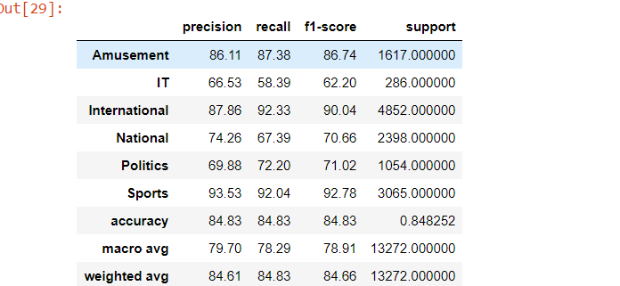
Model Evaluation
LSTM and GRU confusion matrix
LSTM
GRU

Slide 15



